Slide 1


RFID BASED
STUDENT ATTENDENCE
SYSTEM
Shuvabrata dey
GOOD MORNING
ETCE – 07
3rd year
Notes:
It is using the background from https://dribbble.com/shots/1588545--Freebie-7-Low-Poly-Backgrounds-svg-png
Template modified by fppt.com

Slide 2

LIST OF STUDENTS:-
NAME ROLL NO
Dibyendu Karan. 02
Pritwish dey. 03
Arunava Maity. 04
Pritam Dutta. 05
Pratik Ghosh. 06
Shuvabrata Dey. 07
Koushik Bhadra. 08
Kunal Mukherjee. 09
Sanatan Samanta. 10

Slide 3


INTERDUCTION
We use RFID(Radio Frequency Identification Device) Technology .
It takes attendance using RFID Tags (or cards) so it is totally digital process.
It save the student’s Data In a MySql Database.
It is password protected and Only Admin can access the Database.
So It is Non-hack able and very user friendly also.
Students check their Attendance at any Time.
Why we make this project?

Slide 4


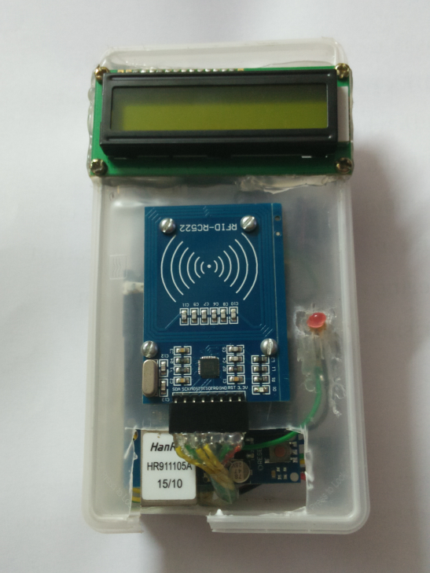

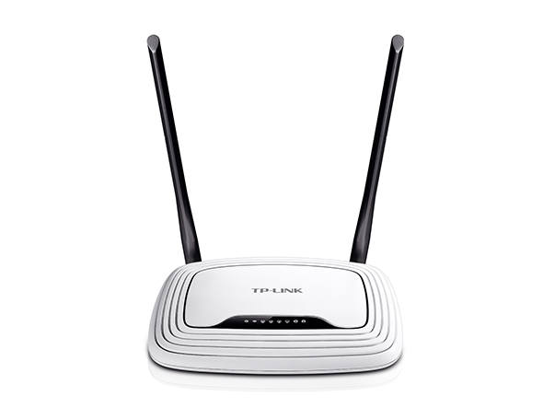

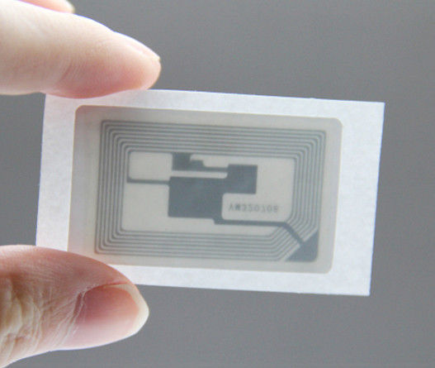

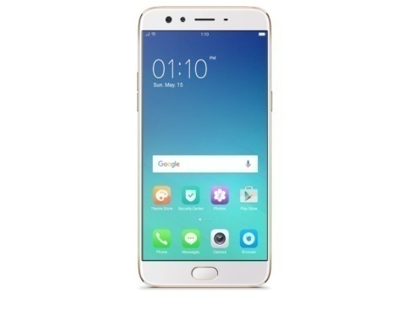
10110
1010101100101101
10101011001011101
10110
10110
UPDATE
1 0 0 1 1 0 1 0
Server
1 0 1 0 1 1
1 0 0 1 1 0
1 0 0 1 1
1 0 0 1 1
DIAGRAM

Slide 5
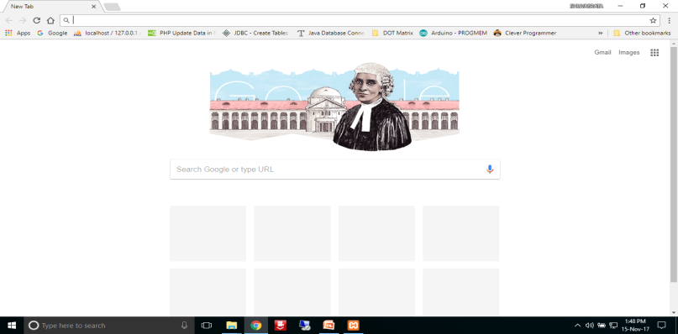
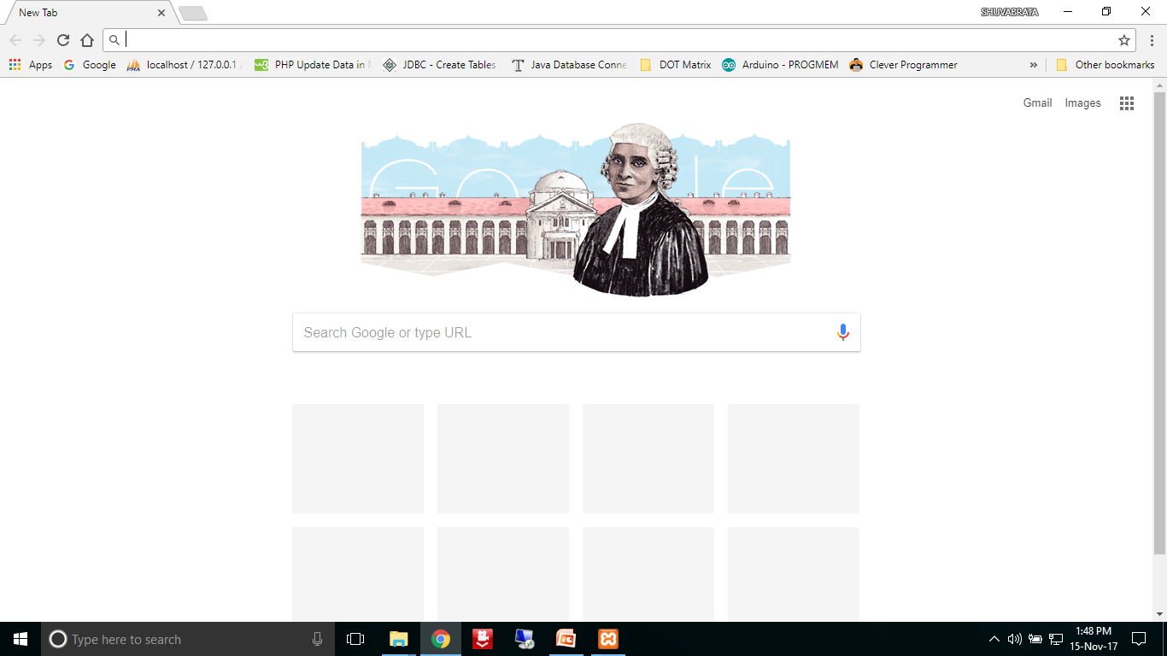
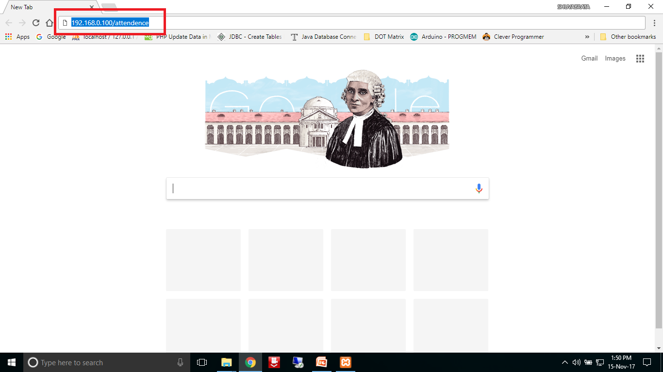
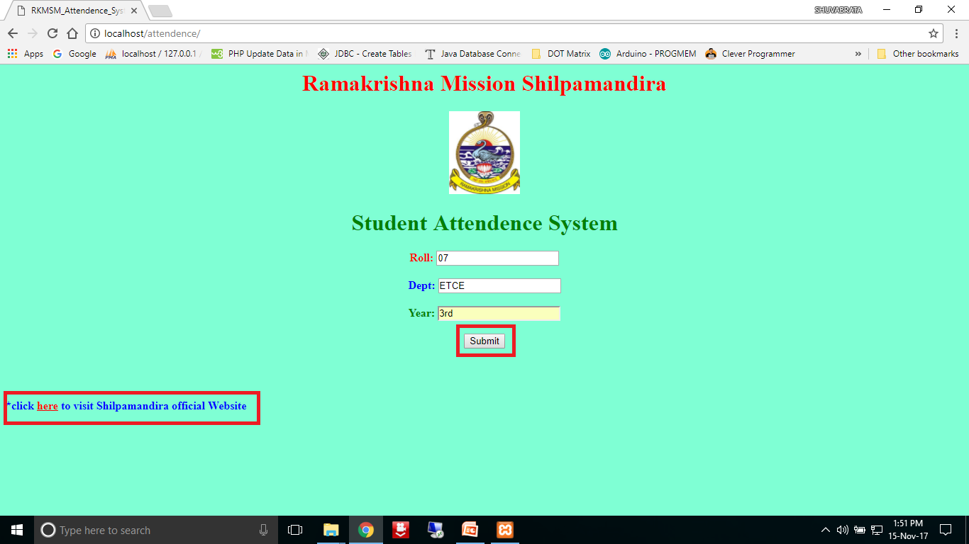
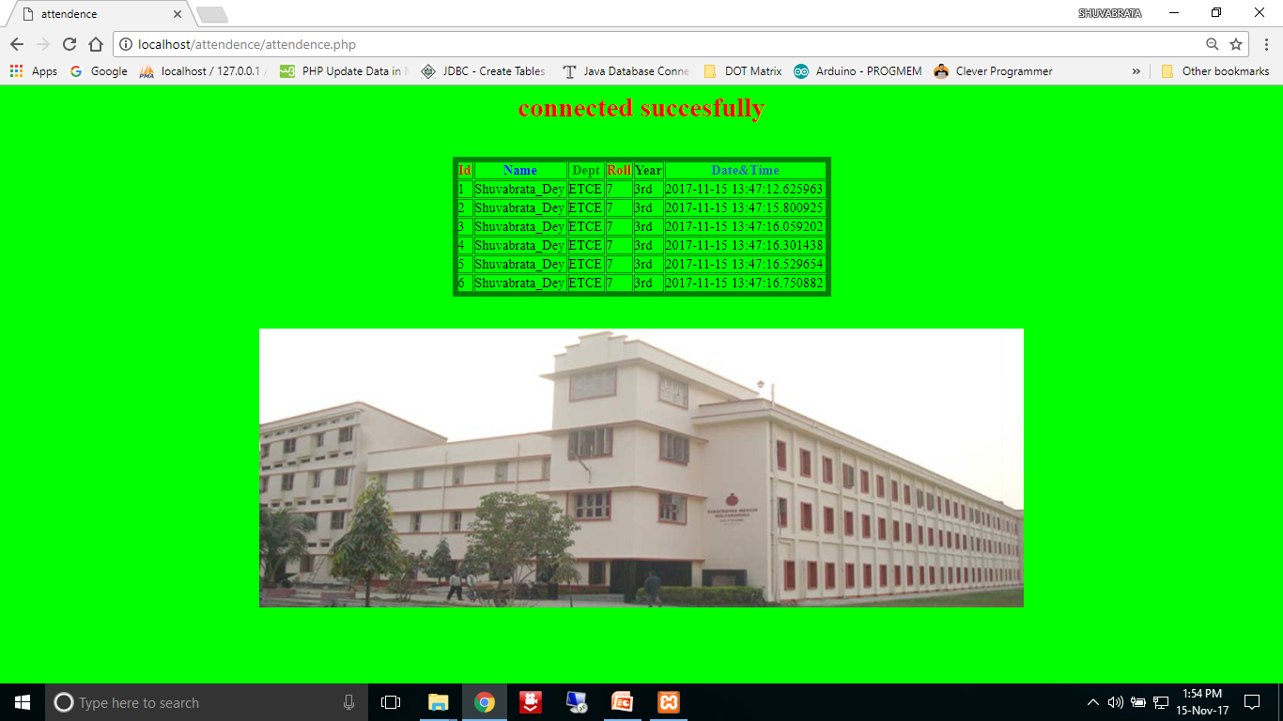
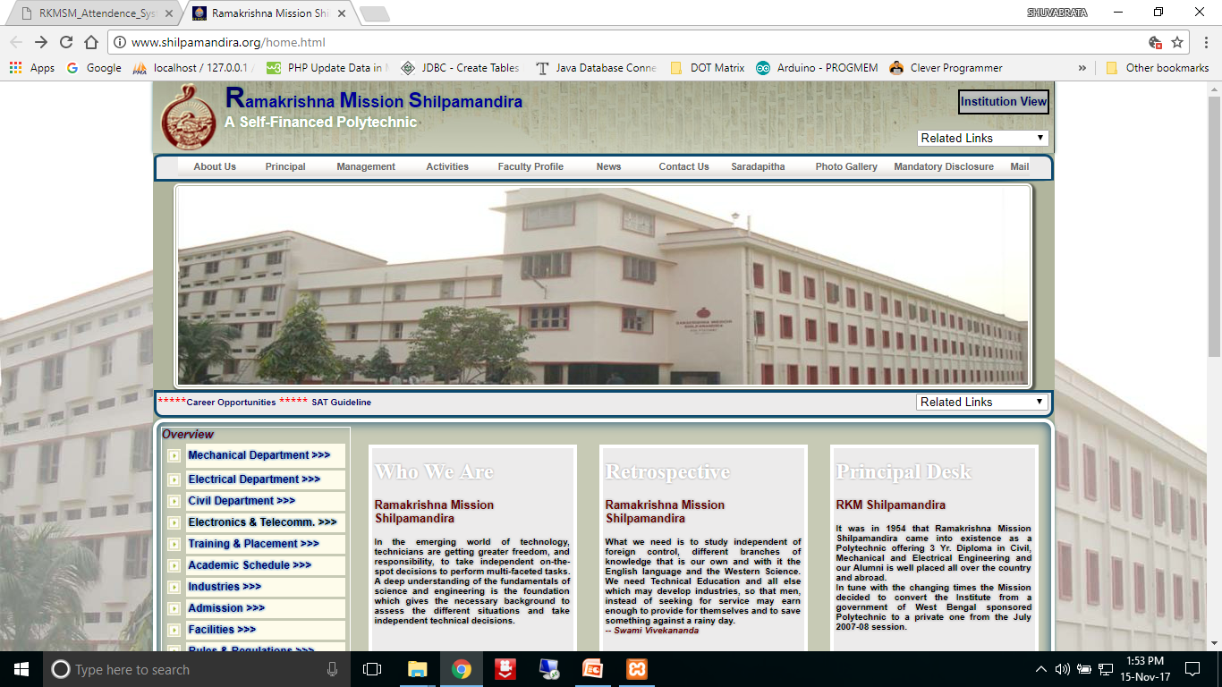

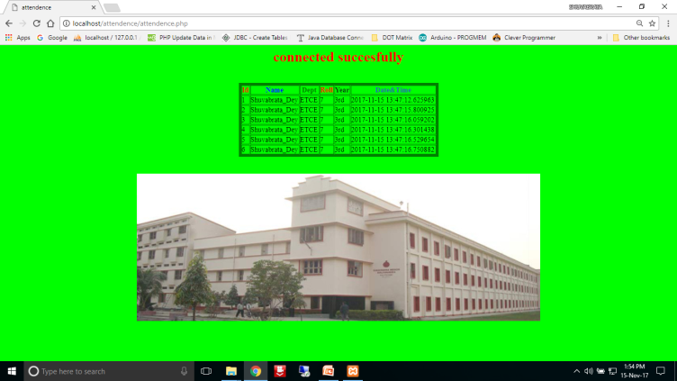

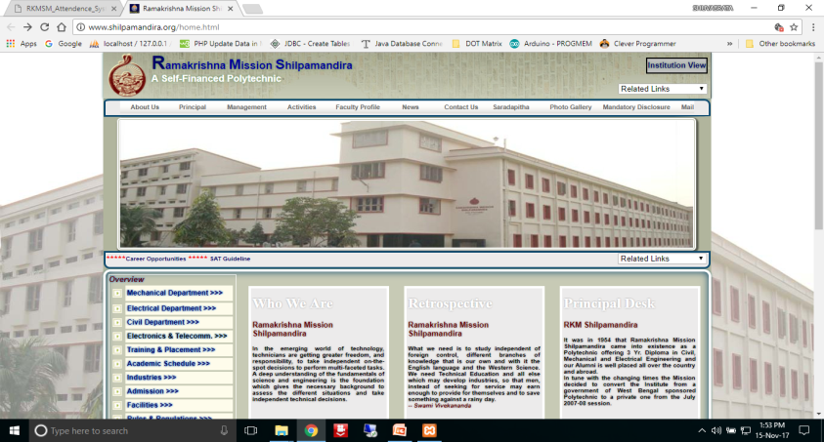
DIAGRAM

Slide 6

LIST OF COMPONENTS :-
SERIAL NO | NAME
1. | ETHARNET SHIELD
2. | Arduino board [we made it]
3. | Computer which runs server inside
4. | RFID MODULE
5. | CLOCK MODULE
6. | 16x2 LCD Display

Slide 7
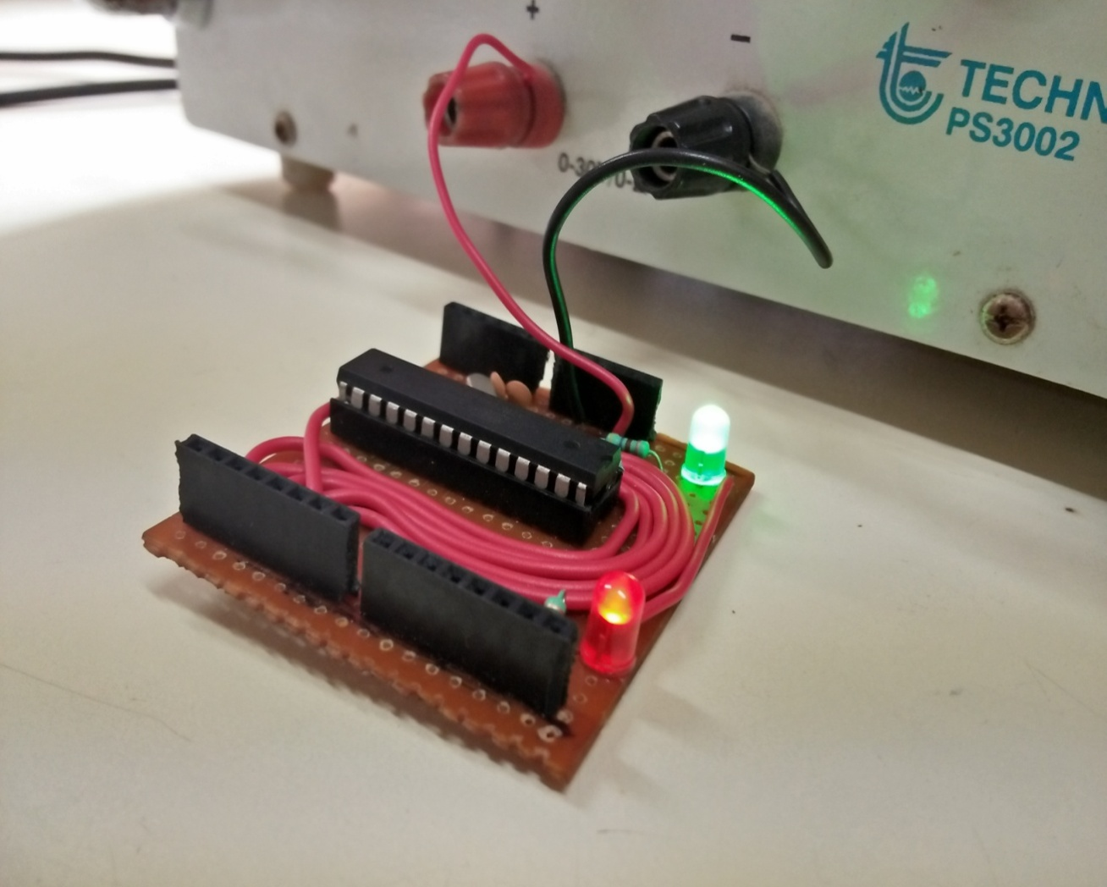
ARDUINO UNO

Slide 8
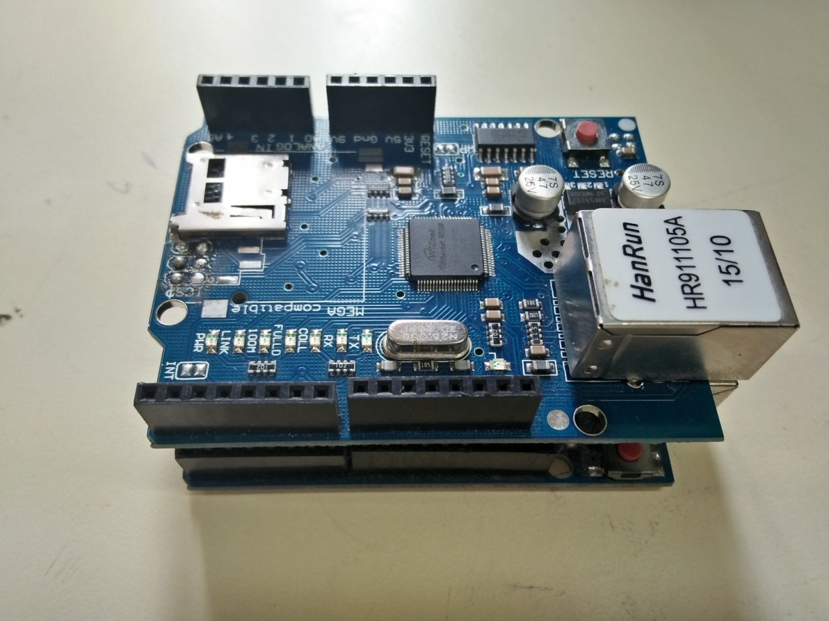
Ethernet Shield

Slide 9
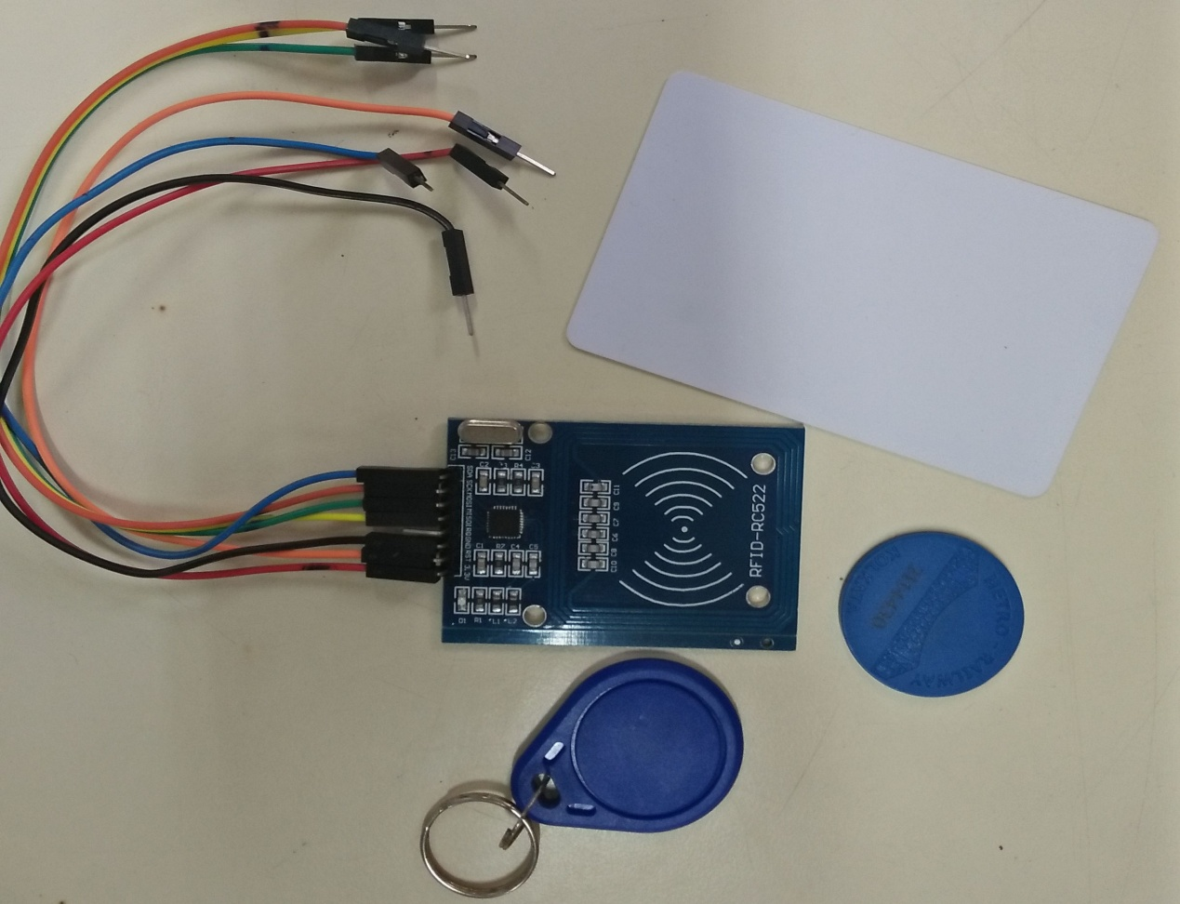
R.F.I.D Module

Slide 10
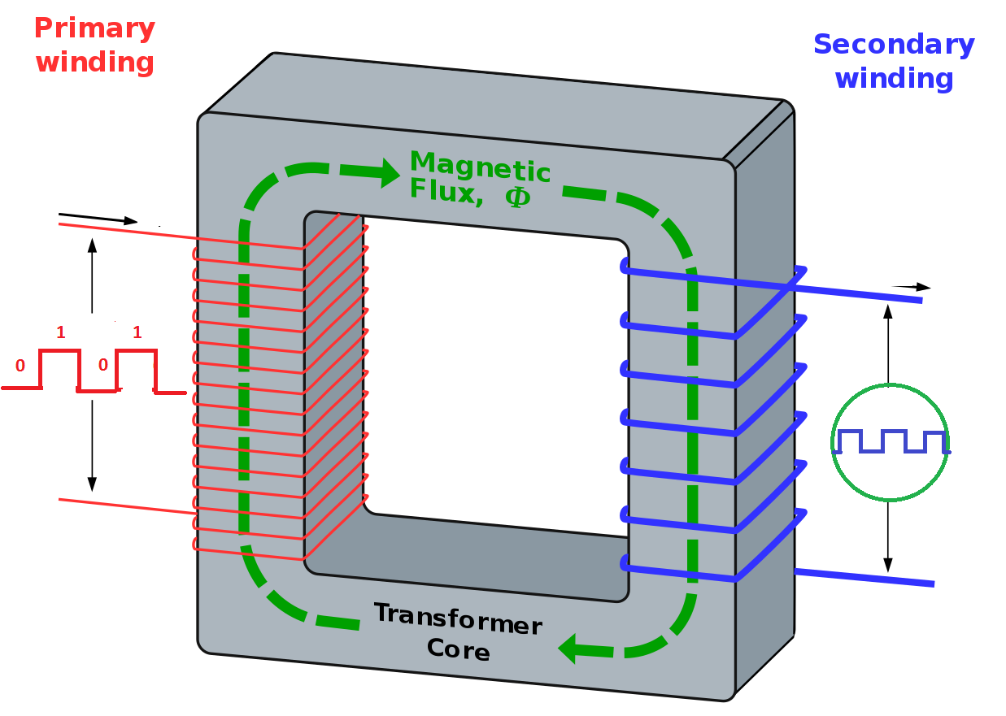
1:1
Input pulse
D.S.O

Slide 11
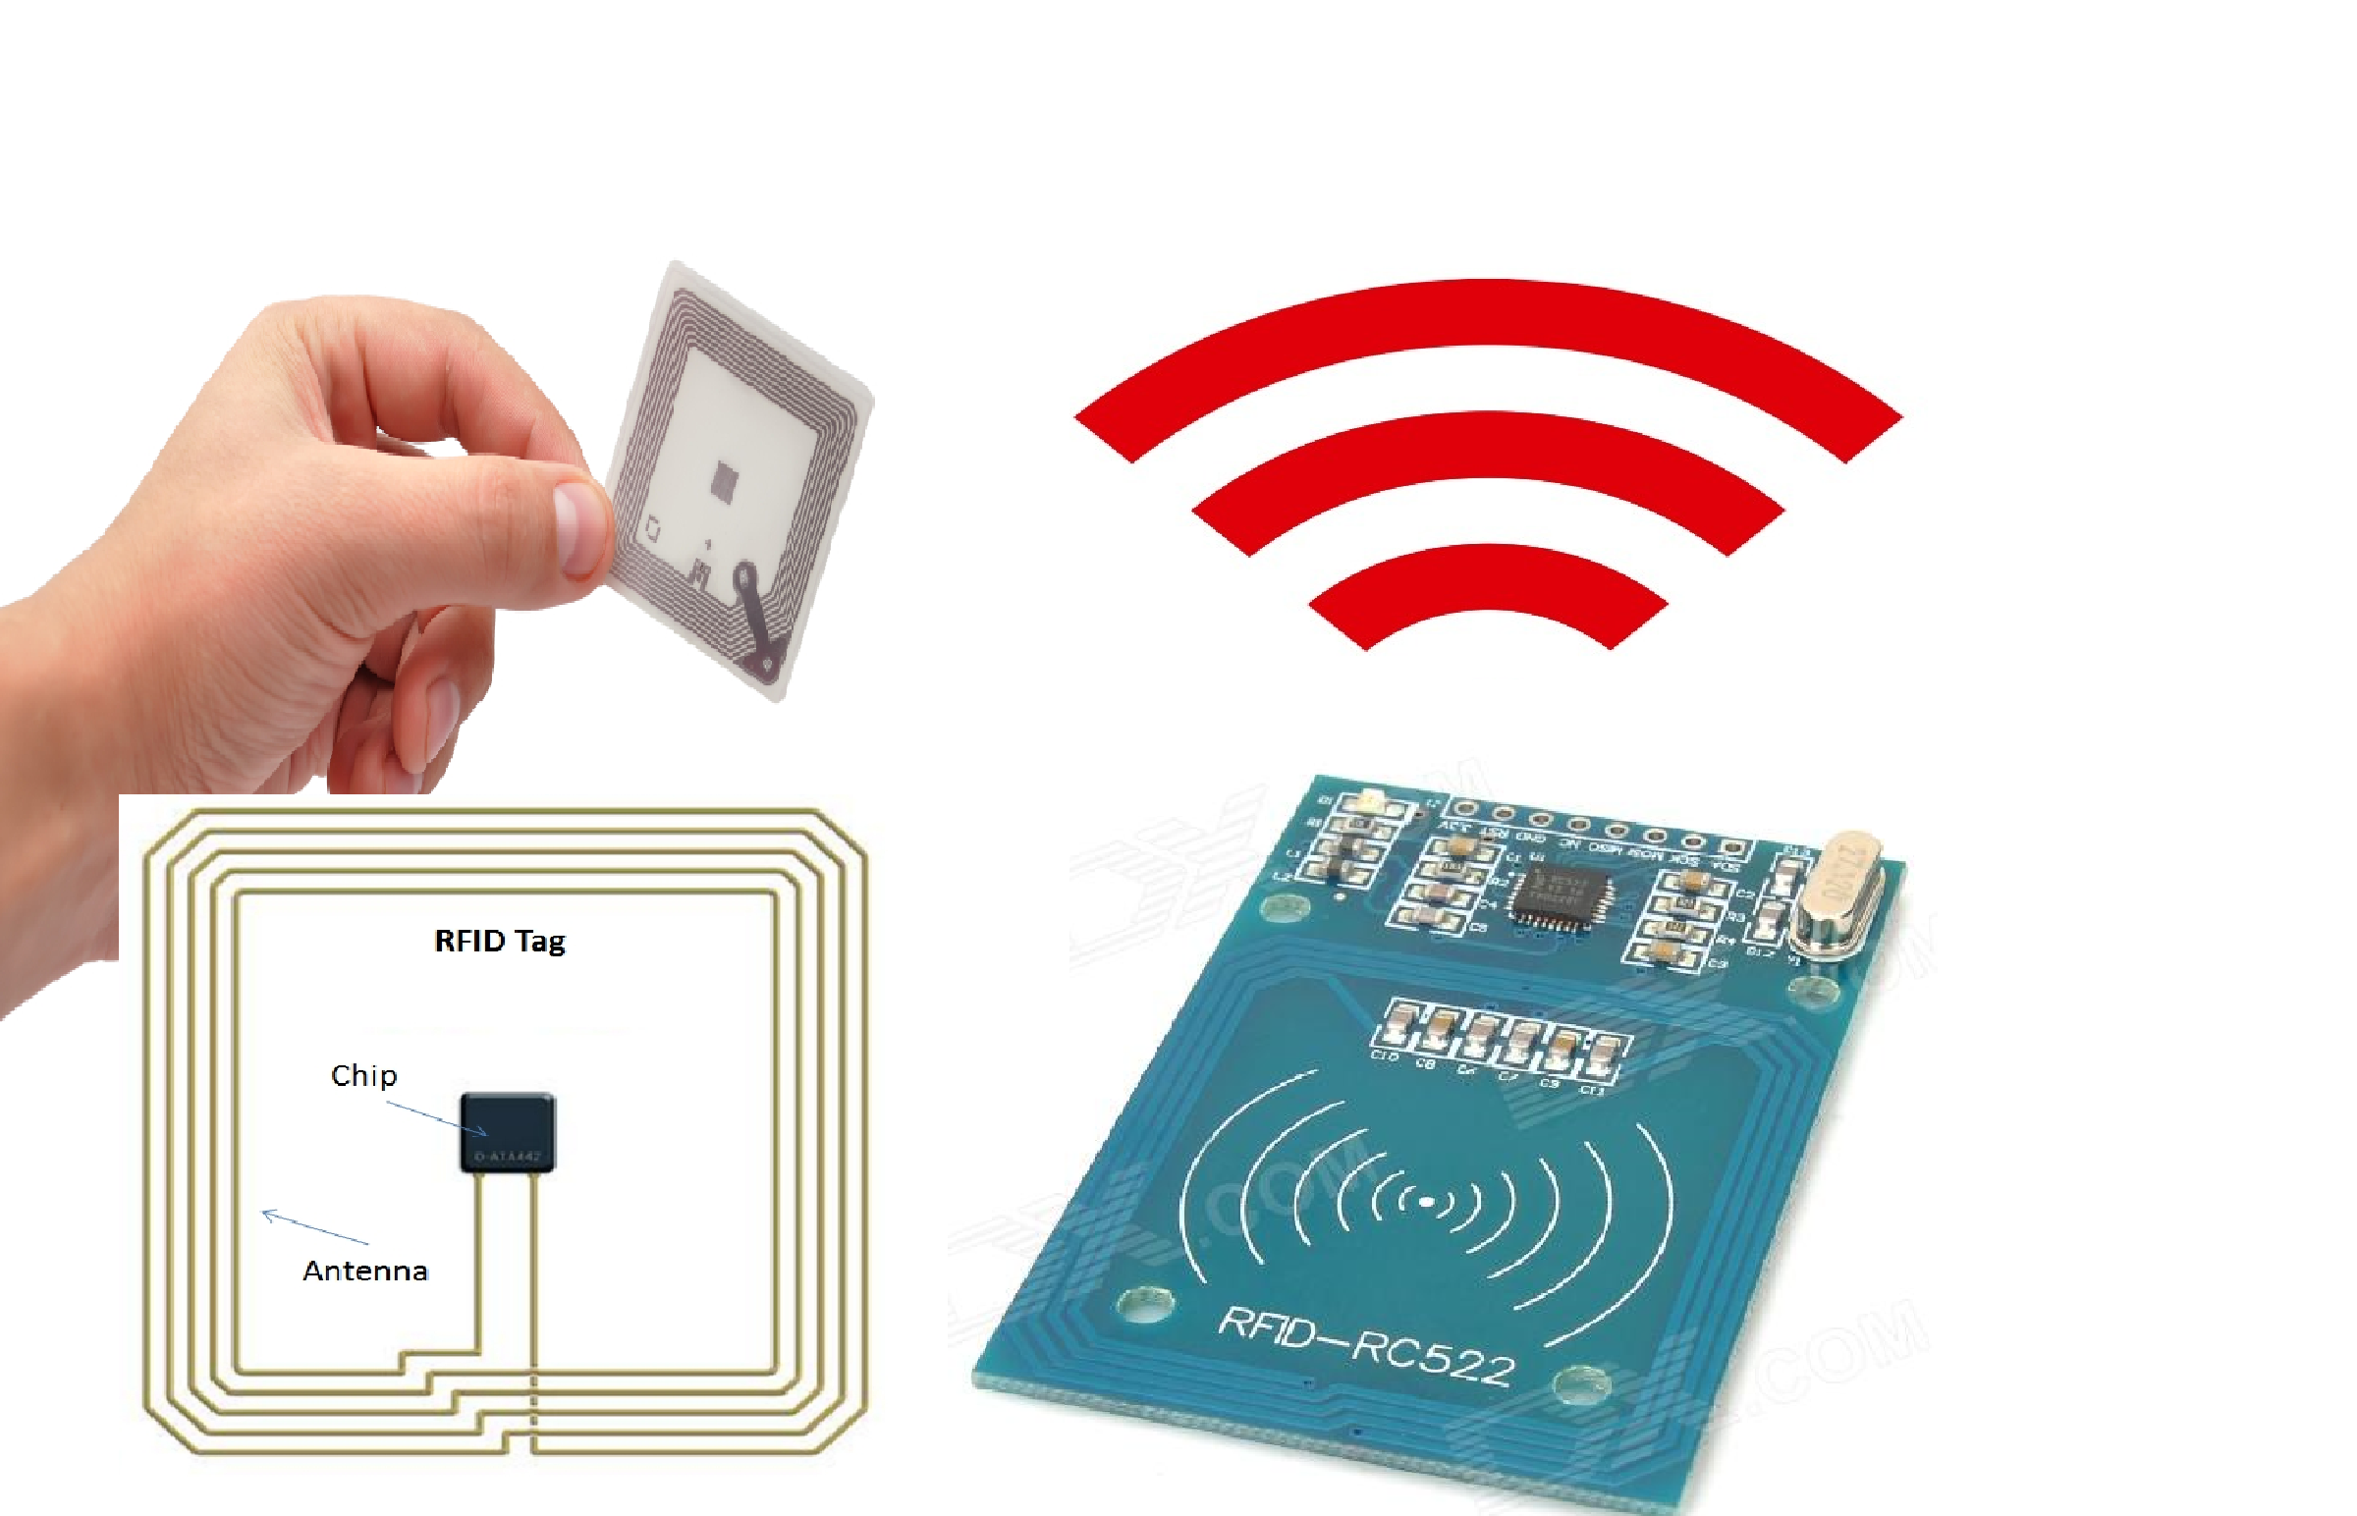

Slide 12
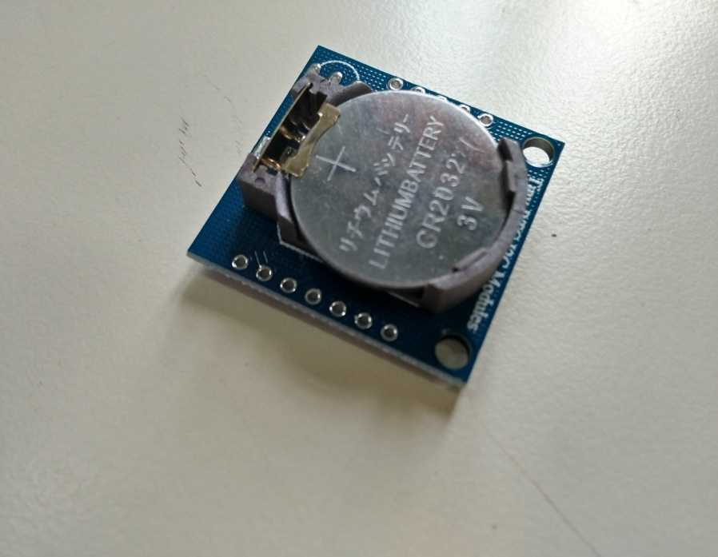
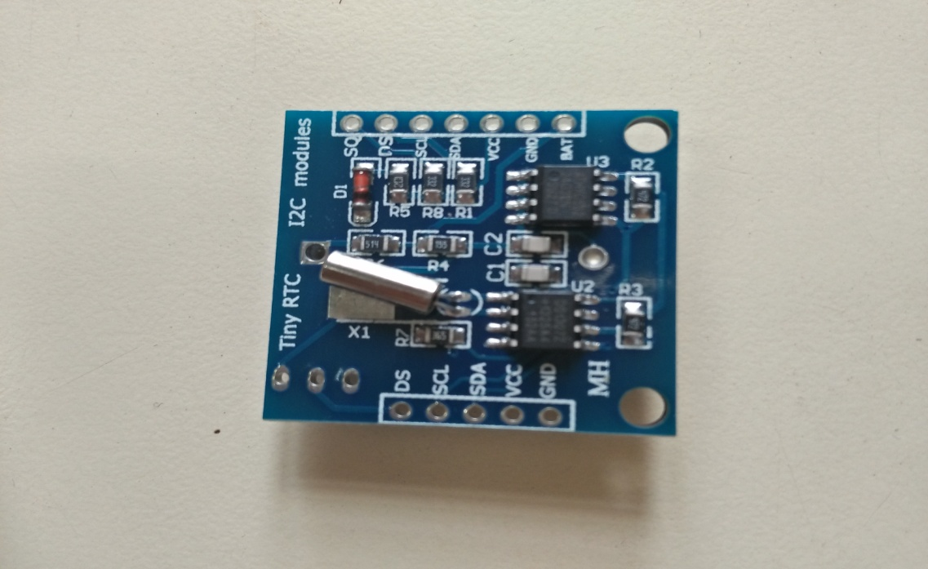
CLOCK Module

Slide 13
What we learn?
LEARN MICROCONTROLLER PROGRAMMING CONCEPT
TO BE FAMILIER WITH ARDUINO MICROCONTROLER SYSTEM
TO GET CONCEPT OF RFID SYSTEM
TO GET A STRONG OVERVIEW ON PRACTICAL KNOWLEDGE OVER THEORETICAL KNOWLEDGE

Slide 14
CONCLUSION:-
In this modern world this device has many
aspects in various practical field. By this
We can store attendance Digitally and so it
is very secure and user friendly. So we
use this kind of device in many places like
school ,college etc.

Slide 15

Thank You

